Slide 1
HEART DISEASE PREDICTION
BY: Uday Prakash Dhande

Slide 2
Aim and Objective
The aim of heart disease prediction is to identify individuals at risk of developing cardiovascular
disorders before symptoms appear. The primary objective is early intervention and preventive measures to reduce the incidence and severity of heart disease. This involves utilizing predictive models, incorporating various risk factors such as age, gender, lifestyle, and medical history, to assess an individual's likelihood of developing heart disease. By predicting risk early, healthcare professionals can implement targeted interventions, lifestyle modifications, and medical treatments to mitigate the progression of heart disease and improve patient outcomes.

Slide 3
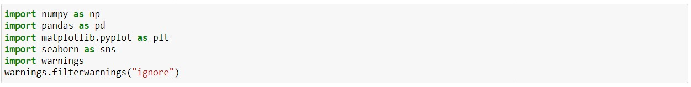
IMPORTING THE BASIC LIBRARIES

Slide 4
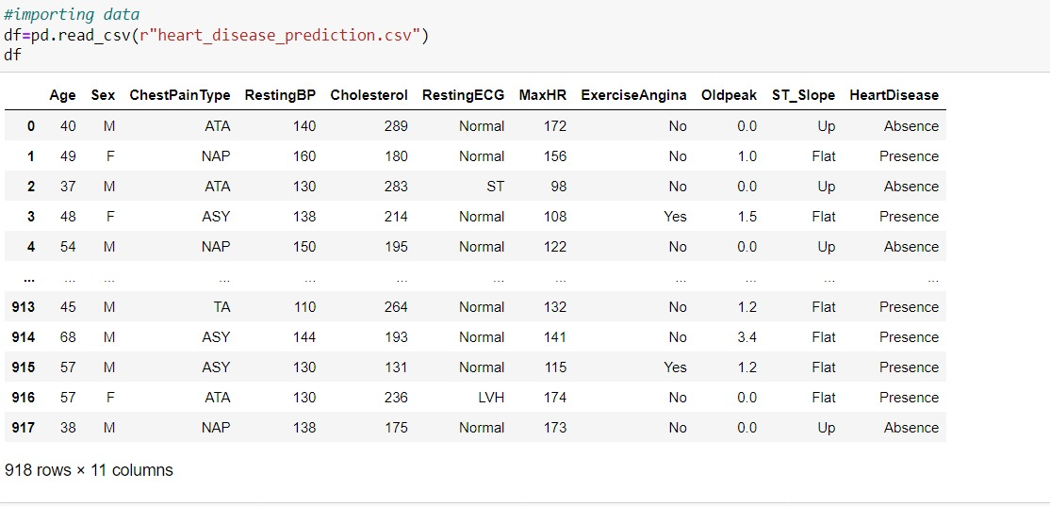
READING THE CSV AS DATAFRAME

Slide 5
FEATURES DISCRIPTION
Age: The age of the individual, usually in years.
Sex: The biological sex of the individual, typically categorized as male or female.
Chest Pain Type: Describes the type of chest pain experienced, often categorized into types like typical angina, atypical angina, non-anginal pain, or asymptomatic.
Resting Blood Pressure: The blood pressure measured when a person is at rest, typically measured in millimeters of mercury (mmHg) and expressed as systolic pressure over diastolic pressure (e.g., 120/80 mmHg).
Cholesterol: The level of cholesterol in the blood, often measured in milligrams per deciliter (mg/dL) or millimoles per liter (mmol/L).
Resting Electrocardiographic Results: The results of an electrocardiogram (ECG or EKG) taken while the individual is at rest, which measures the electrical activity of the heart.
Maximum Heart Rate Achieved (MaxHR): The highest heart rate achieved during a period of exertion, often measured in beats per minute (bpm).
Exercise-Induced Angina: Whether the individual experiences angina (chest pain or discomfort) during physical exertion.
Oldpeak: ST depression induced by exercise relative to rest, which is a measure used in assessing cardiovascular health during exercise stress testing.
ST slope: Describes the slope of the ST segment on an electrocardiogram. Changes in the ST segment can indicate heart ischemia or injury.
Heart disease: A general term used to describe various conditions that affect the heart, including coronary artery disease, heart attacks, arrhythmias, and heart failure.

Slide 6
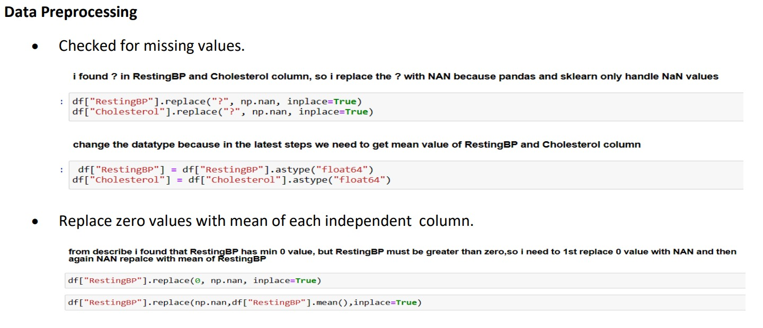
CHECKING FOR MISSING VALUES

Slide 7
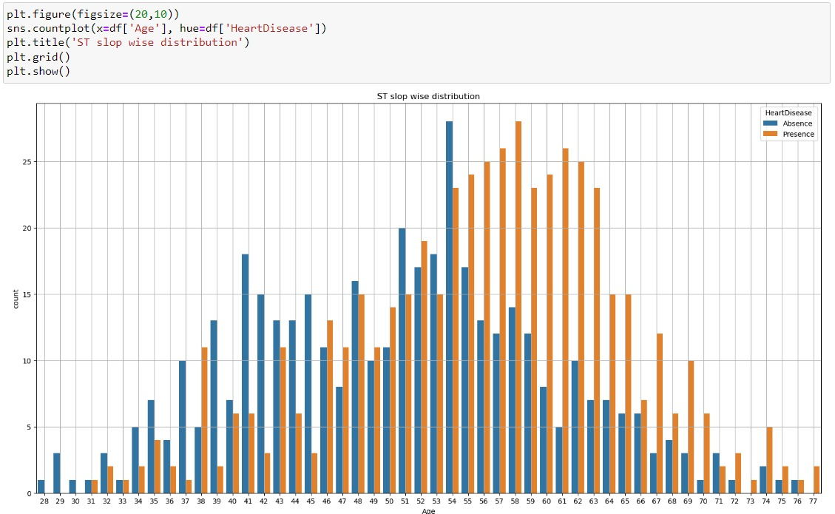
VISUALIZING THE DATA

Slide 8
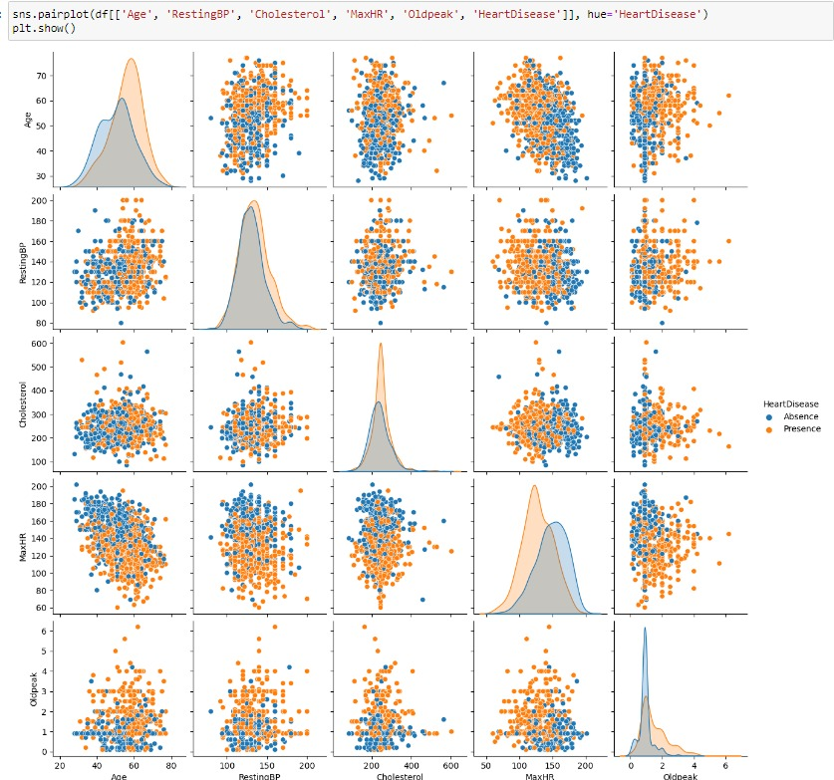
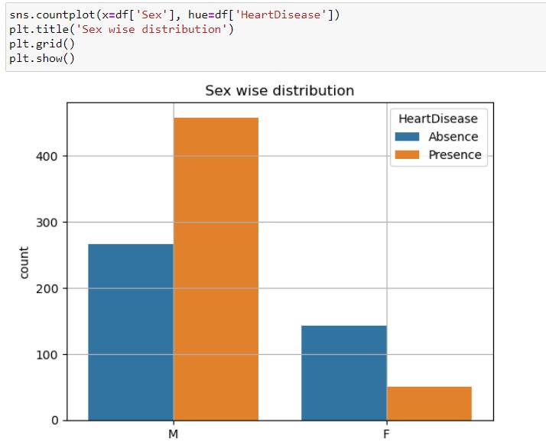

Slide 9
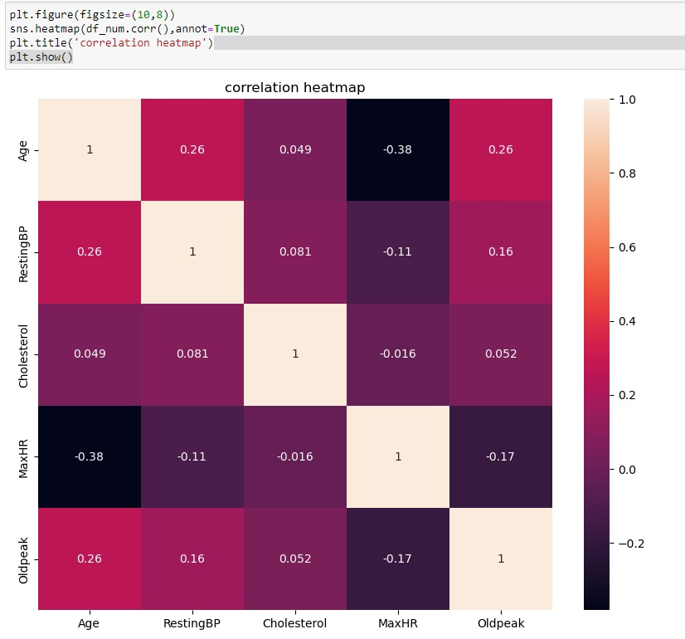

Slide 10
INSIGHTS
Target: Heart disease (0 = no, 1 = yes)
Heart disease risk factors to the following: high cholesterol, high blood pressure, diabetes, weight, family history and smoking .
According to another source , the major factors that can't be changed are: increasing age, male gender and heredity.
Major factors that can be modified are: Smoking, high cholesterol, high blood pressure, physical inactivity, and being overweight and having diabetes.
Other factors include stress, alcohol and poor diet/nutrition.

Slide 11
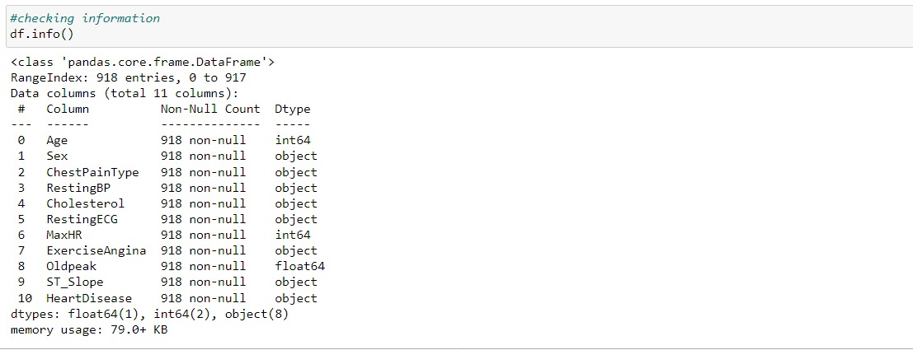
INFORMATION ABOUT DATAFRAME

Slide 12
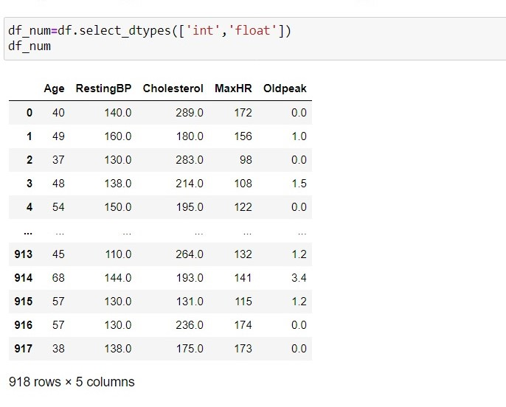
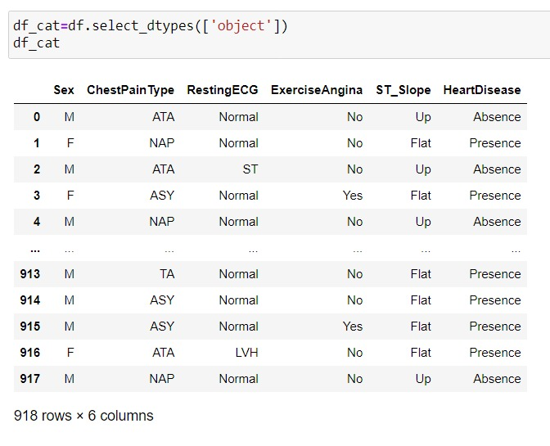
SEPRATING NUMERICAL & CATEGORIAL COLUMN

Slide 13
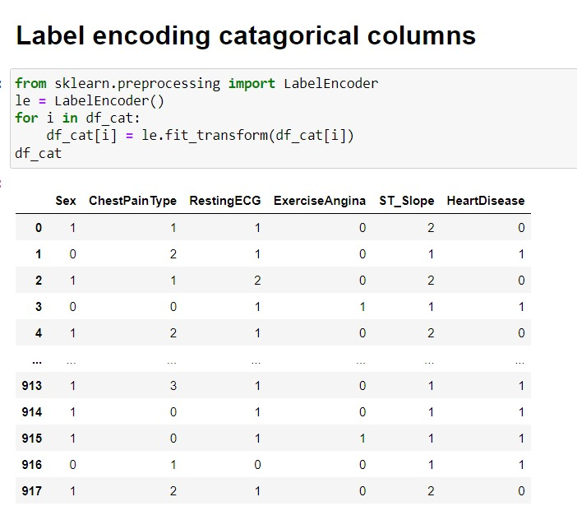
Label Encoding

Slide 14
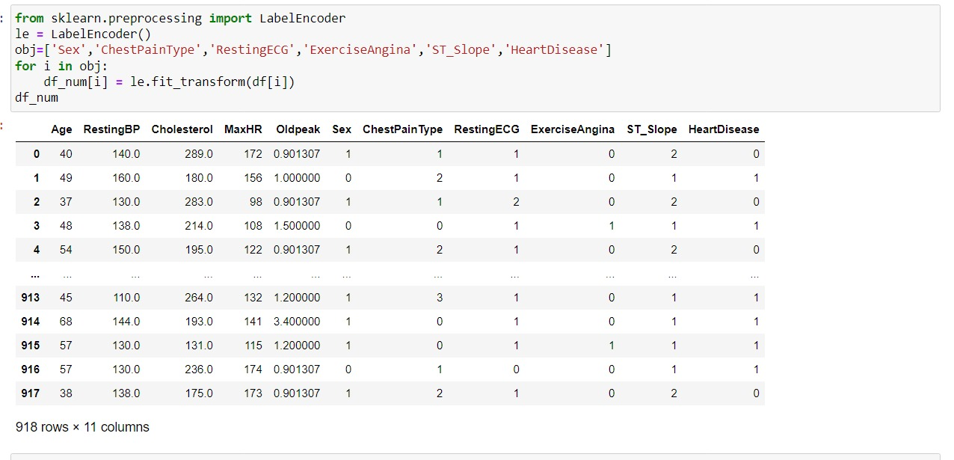
CONVERTING ALL COLUMN INTO NUMERICAL

Slide 15
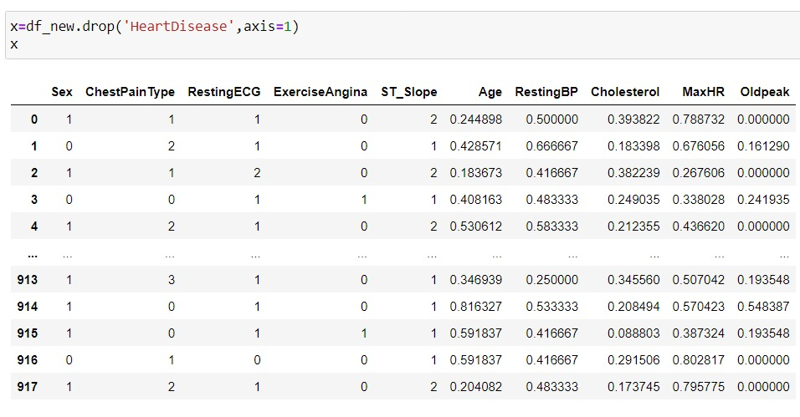
Droping the column

Slide 16
As now the data is converted and EDA is done moving to Machine learning

Slide 17
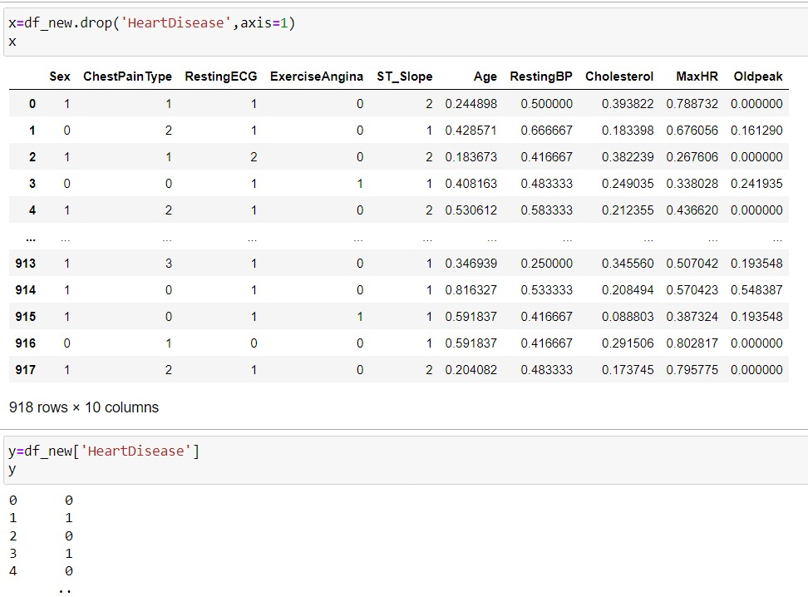
Dividing the dataset into X & Y

Slide 18
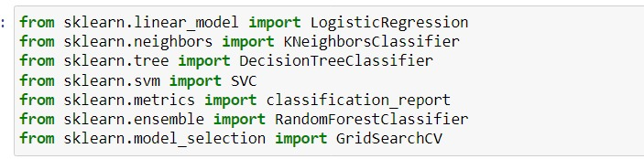
Applying different Machine Learning algorithms

Slide 19
Split the data into training and testing sets

Slide 20
Model Building & Trainng Data
We build a machine learning model from features-label pairs, which comprise our training set. Our goal is to make accurate predictions for new, never-before-seen data.
There are two major types of supervised machine learning problems, called classification and regression. Our data set comes under classification problem.
Logestic Regression
k-Nearest Neighbors classifier
Decision Tree
Random Forest
Super vector machine(svc)
XG boost classifier

Slide 21
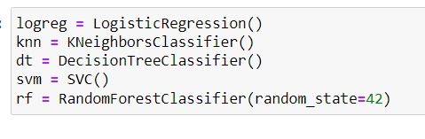
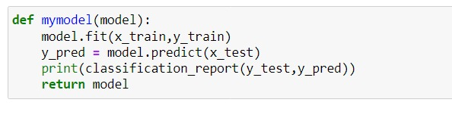
Defining a function to different models

Slide 22
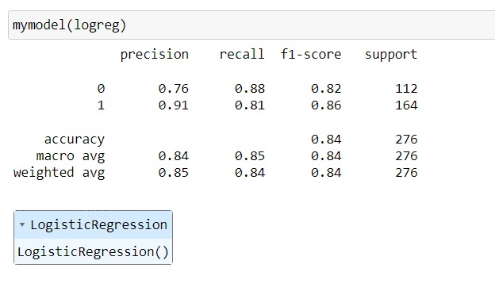
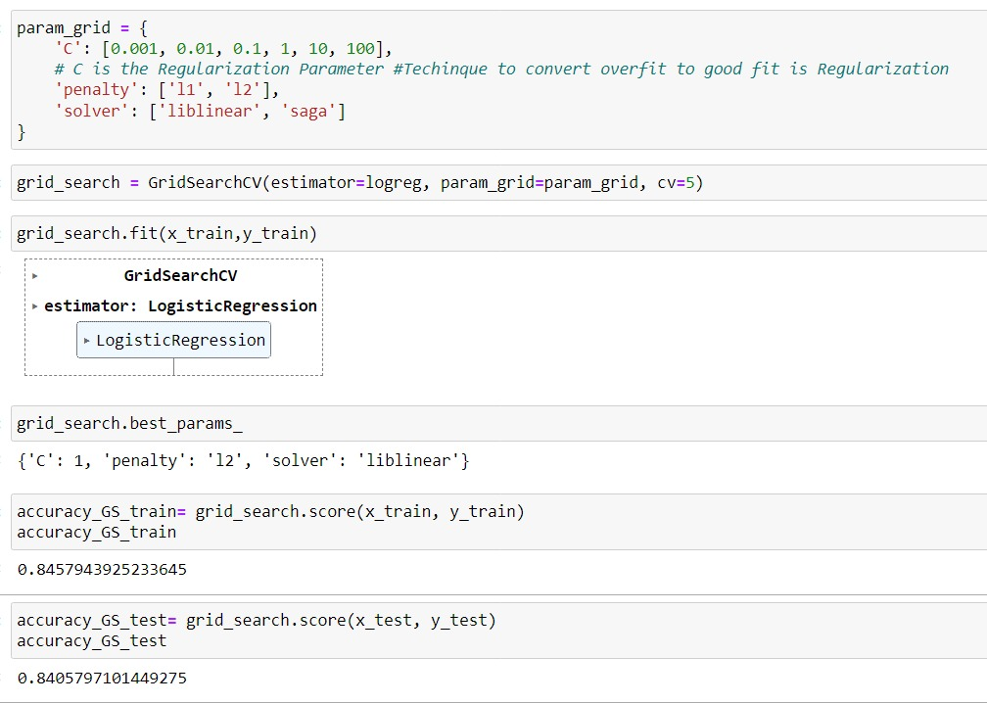
Logistic Regression & Hypertuning LG

Slide 23
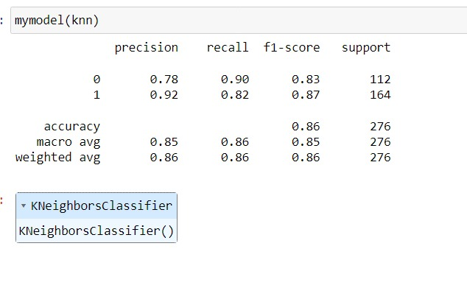
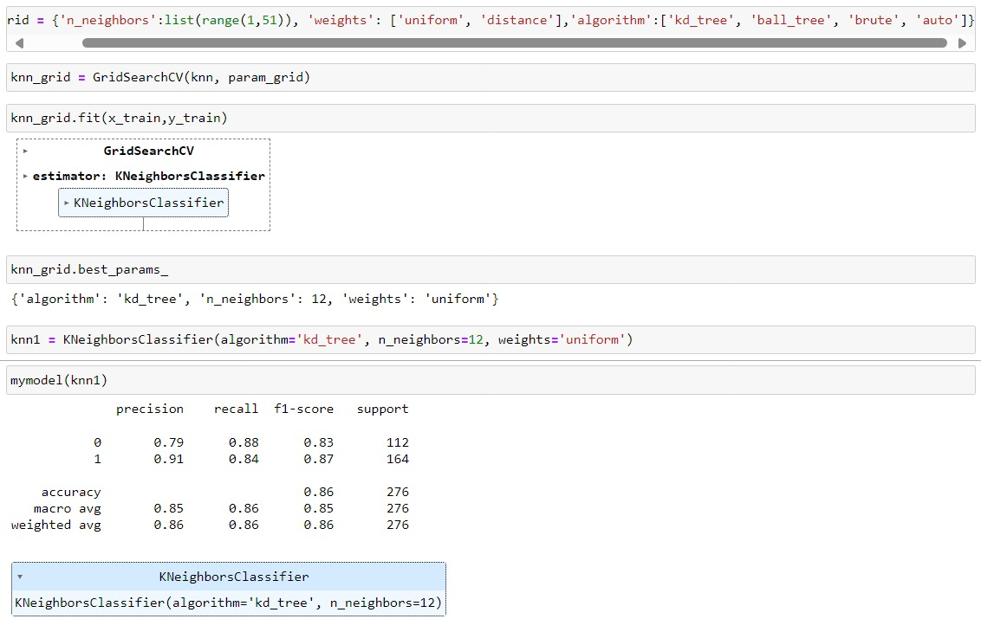
KNeighbors Classifier & Hypertuning KNN

Slide 24
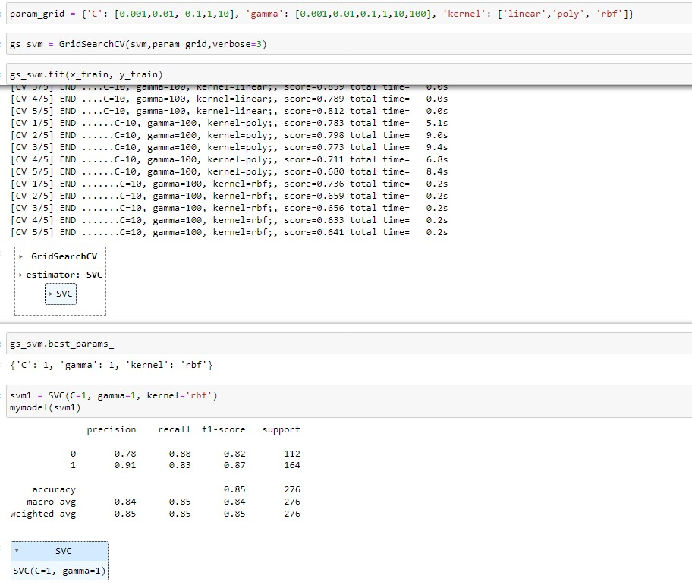
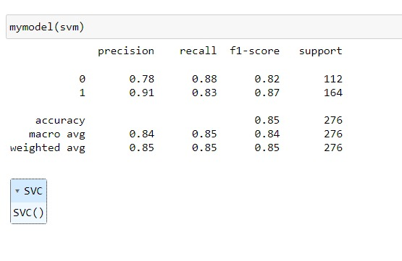
Support Vector Machines (SVM) & Hypertuning of SVM

Slide 25
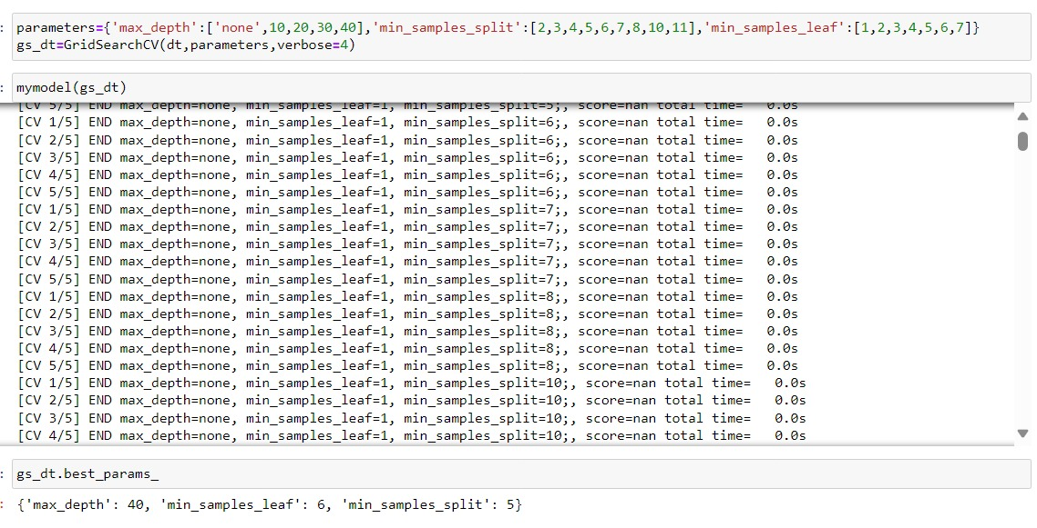
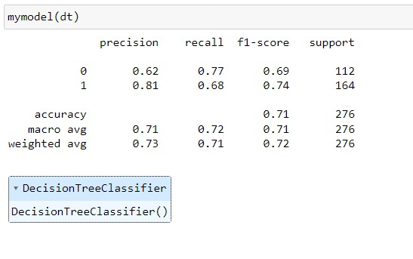
Decision Tree & Hypertuning DT

Slide 26
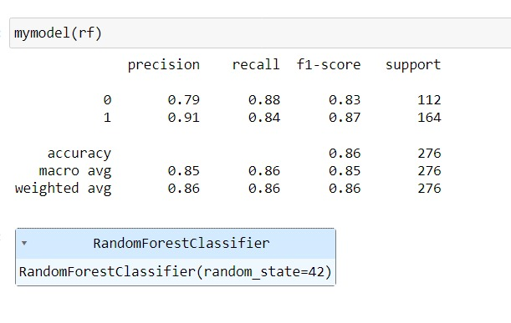
Random forest

Slide 27
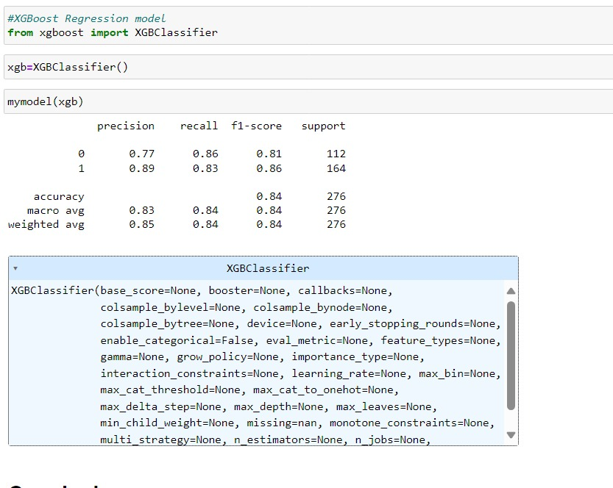
Xgboost classifier

Slide 28
Machine Learning Algorithms Used :
Logistic Regression Accuracy=84%
Decision Tree Accuracy=74%
Random forest Accuracy=86%
Support Vector Machine (SVM) Accuracy=85%
KNeighbors Classifier Accuracy=86%
Xgbooster classifier Accuracy=84%
Machine Learning Algorithms Used :
Logistic Regression Accuracy=84%
Decision Tree Accuracy=74%
Random forest Accuracy=86%
Support Vector Machine (SVM) Accuracy=85%
KNeighbors Classifier Accuracy=86%
Xgbooster classifier Accuracy=84%

Slide 29
CONCLUSION
Through comprehensive analysis of various risk factors, including lifestyle, medical history, and genetic predispositions, the predictive model reliably forecasts the likelihood of developing heart disease. By leveraging advanced machine learning algorithms, it facilitates early intervention and personalized preventive measures, ultimately aiming to reduce the burden of cardiovascular ailments on public health. This predictive tool offers a vital step towards proactive management and improved outcomes in cardiovascular health.

Slide 30
THANK YOU

